Slide 1


Dongseo University
Computer Engineering
Software Development Project1
[ Project Name : Game of thrones]
Team members:
20152778 Sardor
20152783 Timur

Slide 2
History
Date | History
Week 1 | HTML CODE
Week 2 | HTML and CSS CODE
Week 3 | CSS CODE
Week 4 | Gathering information and photos
Week 5 | Decoration of web site. Translation into Russian
We have 43 html and 1 CSS pages

Slide 3
Site Map
Main
Contact us
Footer
About
Russian
Other links
Noble Houses
Seasons
Gallery
Sardor & Timur
History of Westeros
All pages in Russian
House Frey
House Greyjoy
House Lannister
House Stark
House Tyrell
House Targarien
House Tully
Jouse Arryn
Main
Gallery
About
Contact us
Facebook Group
Instagram group
Season 1
Season 2
Season 3
Season 4
Season 5
Season 6
Season 7
Gallery 1-page
Gallery 2-page
Gallery 3-page
Gallery
Families
Other links

Slide 4
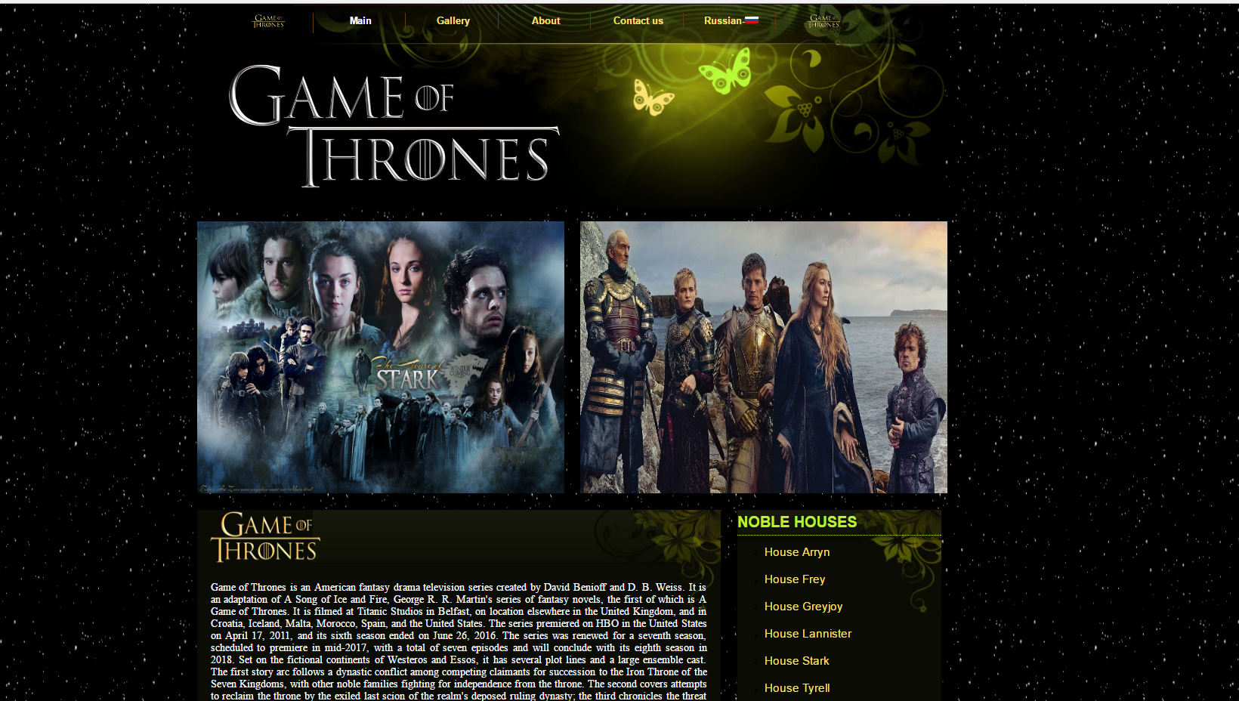
LOGO
LOGO
LOGO
Snowing
LOGO

Slide 5
MAIN MENU
Russian language
Gallery
About
Contact us

Slide 6
Information about houses

Slide 7
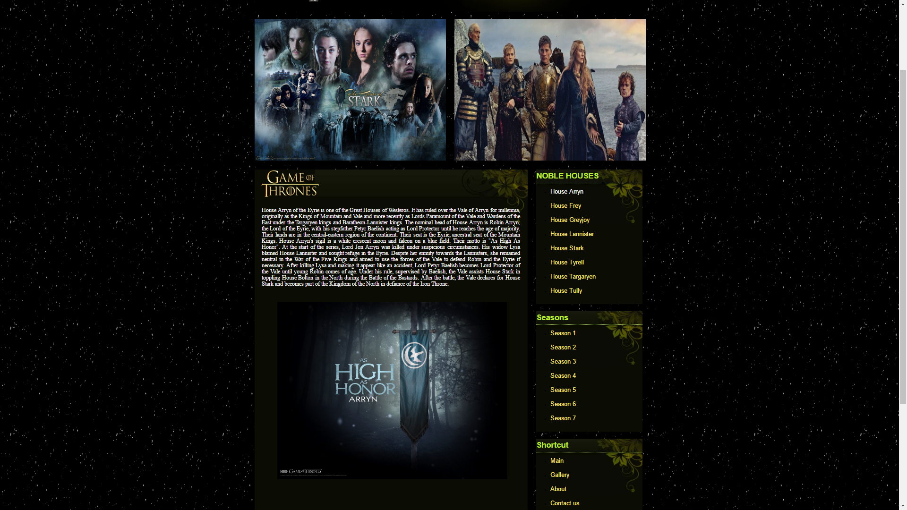

Slide 8
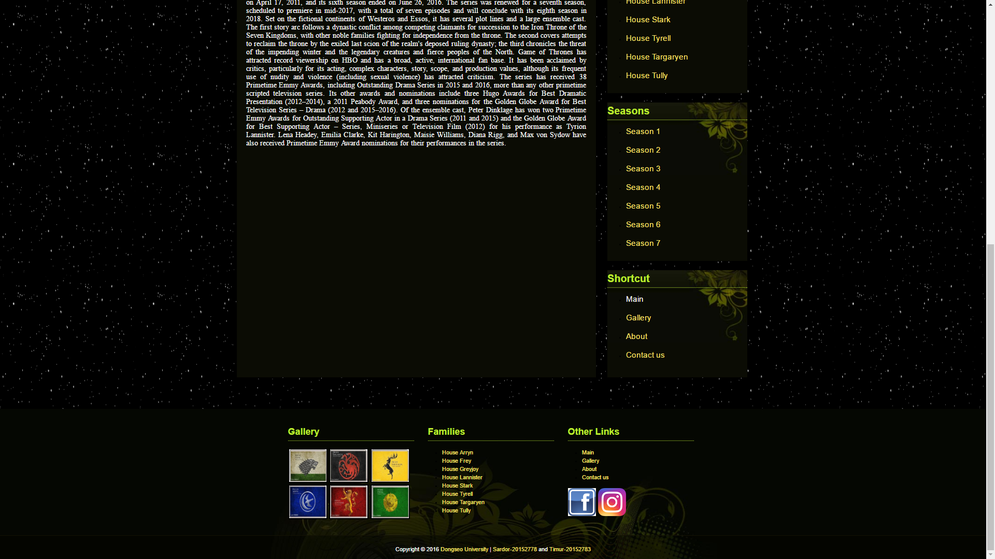
Information about seasons
Information about families
Gallery
Group on Instagram
Group on Facebook

Slide 9
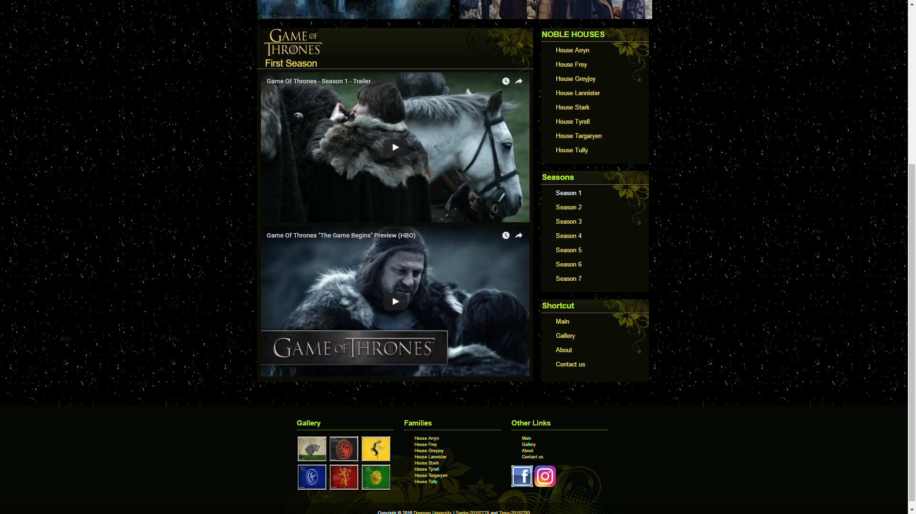

Slide 10
Contact us

Slide 11
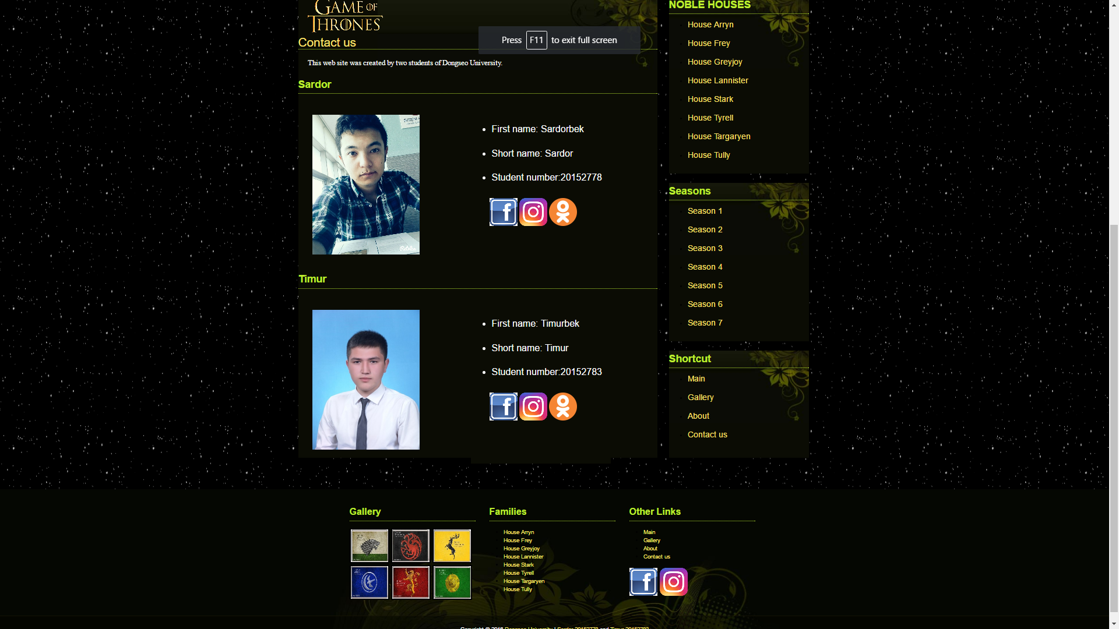
Profiles in social networks
Profiles in social networks

Slide 12
Gallery

Slide 13
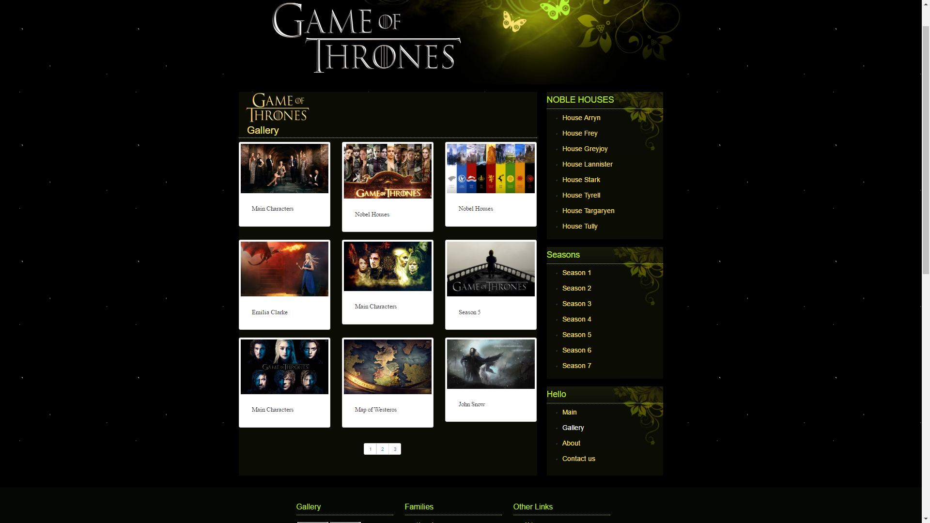
Second page

Slide 14
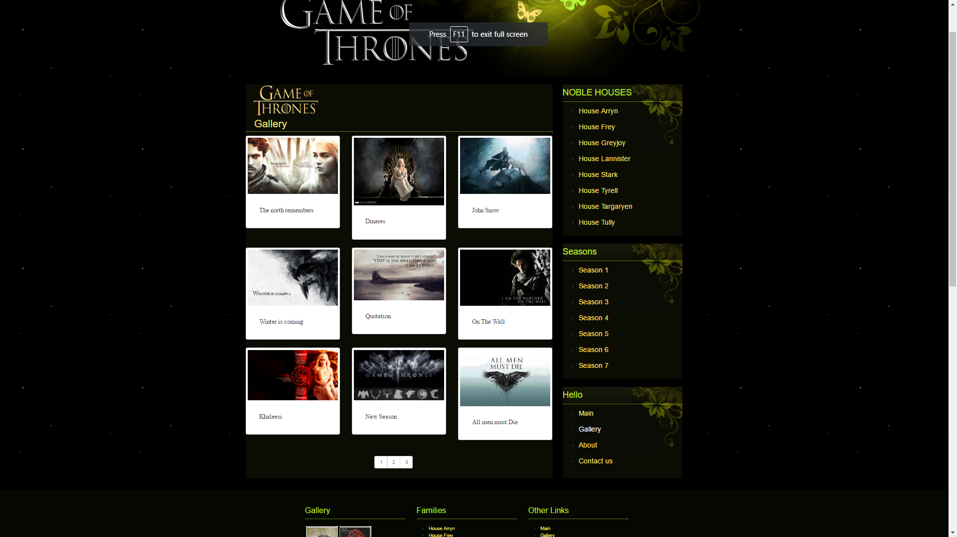

Slide 15
Russian Language

Slide 16
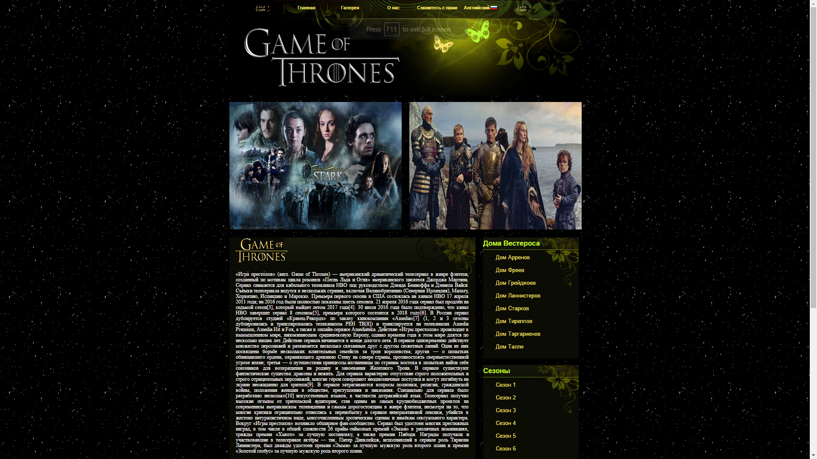

Slide 17
FUTURE PLANS
-Making chatroom.
-Add some details.
-Add comments.
-Learn server and database.
-Add sounds.
-Some interesting online games in website (with our users).
-Add some code from JavaScript, Parallax and Python.

Slide 18
